Slide 1
Tooth Segmentation Internship
by Sarah Kim

Slide 2
Note:
All code was done in Java, not python.
This presentation assumes basic familiarity with data science and optimization terms and concepts (for example gaussian mixture, level set optimization, maximum flow algorithm)
This presentation gives an overview of what I did in the internship, especially because I am not allowed to upload the actual code on github

Slide 3
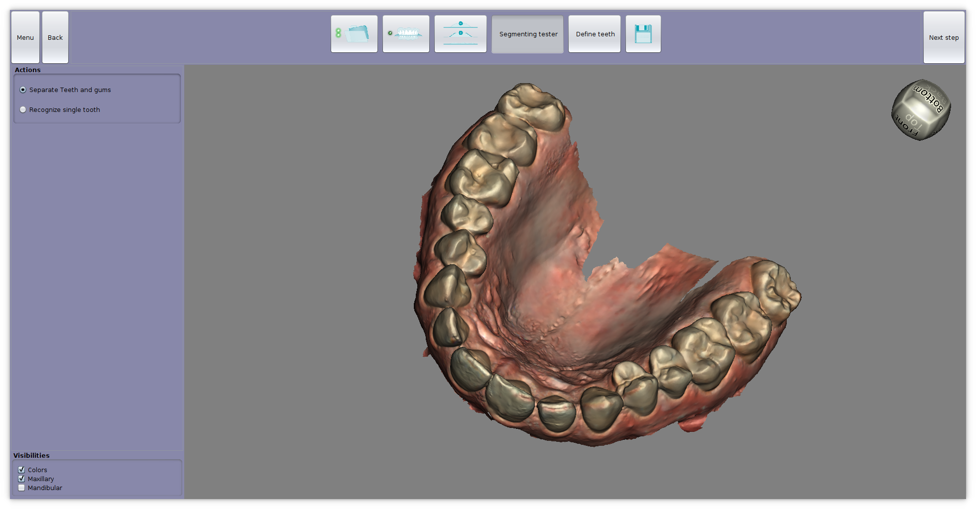
Original Mouth Scan– bottom part

Slide 4
Tasks
1. Recognize teeth and gums on a mesh taken from human dental scans. The software should color the teeth in one color and the gums in another.
2. Recognize one tooth from another on a mesh created from people's tooth scans. When you click anywhere on a tooth, only that tooth should be colored.

Slide 5
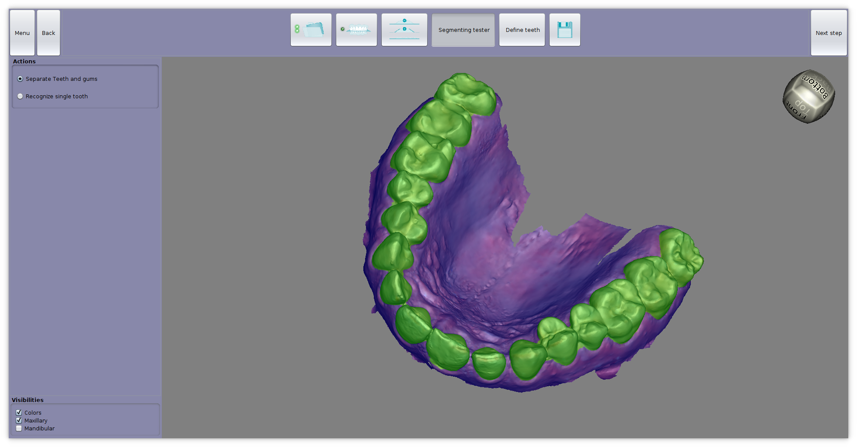
1) Tooth vs. Gum Segmentation

Slide 6
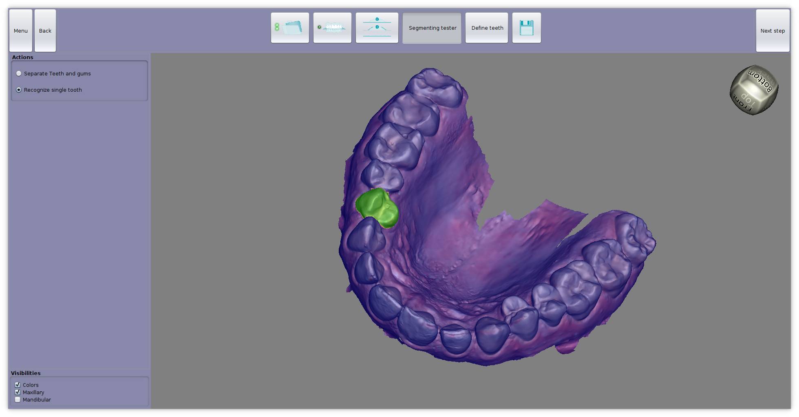
2) Clicked tooth vs. other teeth Segmentation

Slide 7
Collect teeth data
Color mouth scans provided by company were then manually labeled by defining the boundary curve of each tooth

Slide 8
Data Processor
Uses FeatureExtractor.java instance to extract feature vectors (color and geometry) for individual vertices and sorts them into separate files depending on class label
Class label is determined from manually input boundary curves
Three classifications: tooth or not tooth, all teeth boundary or not boundary, singleTooth boundary vs nonSingleTooth boundary

Slide 9
Calculate curvature
Determine surface coordinate system from normal vector
Use linear regression to locally fit quadratic surface
Calculate 2 Eigenvalues (bc 2 x 2 Matrix, bc 2 tangential directions), 2 Eigenvectors info to get info on curvature
Eigenvalues: of quadratic term of quadratic surface
Transform from surface coordinates to “cylindrical” global coordinates

Slide 10
Trainer.java
Takes the labeled feature vectors from DataProcessor and fits statistical models (Gaussian, GaussianMixture, LogisticRegression) to it
It then outputs the parameters for these models, which are manually inserted into ActualConfig.java

Slide 11
GaussianMixture vs LogisticRegression
GM— used only for color: models probability density over the color space, which is used to tell teeth and gum apart. This is more accurate than simple Gaussian as model
LogReg (supervised learning): probabilistically predicts binary class label in the form of probability distribution over two elements
At the end, we only used LogReg it directly classifies

Slide 12
Probability guided segmentation Algorithmn
To maximize probability that whole segmentation separates gum and teeth by minimizing the –log of the probability
Probability is modeled as a product of independent probabilities for each vertex being tooth, and for each connecting edge being boundary between tooth and gum
This means the –log is a sum of two kinds of terms, for verts and edges
Used both level set based (*) and maximum flow based(*) solution techniques for this optimization problem

Slide 13
SegConfigData interface
Allows us to quickly change implementation of the actual segmentation algorithm
For example, we can switch between level set and maximum flow solver

Slide 14
Nonlinear Optimization
We used gradient descent (with fixed learning rate), or Euler integration (with specific differential equation), for the level set based probability maximizer
We applied newton method to fit the logisticRegression classifiers (teeth vs gum, boundary vs nonboundary)
Expectation maximization algorithm for learning of gaussian mixture model

Slide 15
Adjustment for single clicked tooth vs teeth
We used very similar approach for separated clicked tooth vs non clicked tooth but with different model parameters and by restricting the whole maximum flow problem to one near the clicked point

Slide 16
The End
Thank you for your time ☺

